Slide 1
13 INDEX

Slide 2

Part 1.
INDEX

Slide 3
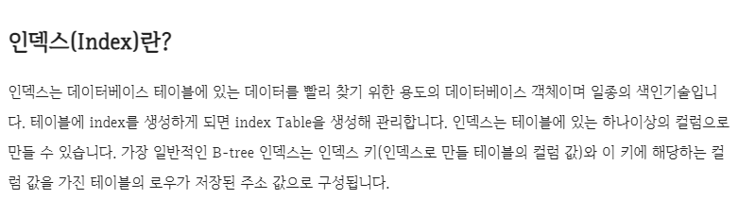
chaper 13
01
INDEX

Slide 4
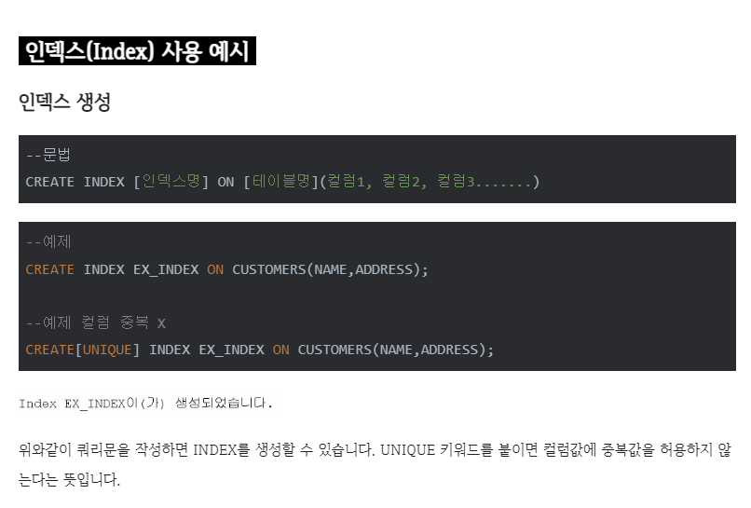
chaper 13
01
INDEX

Slide 5
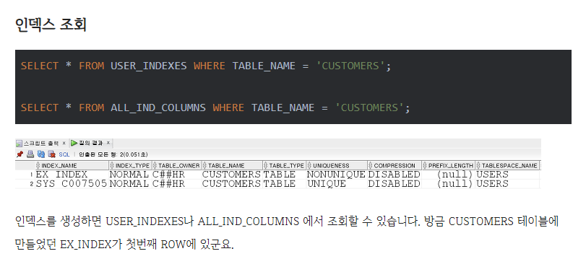
chaper 13
01
INDEX

Slide 6
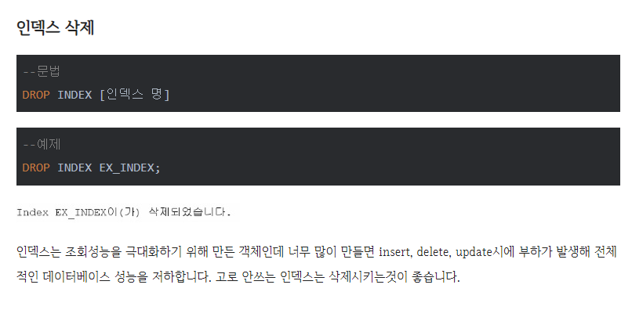
chaper 13
01
INDEX

Slide 7
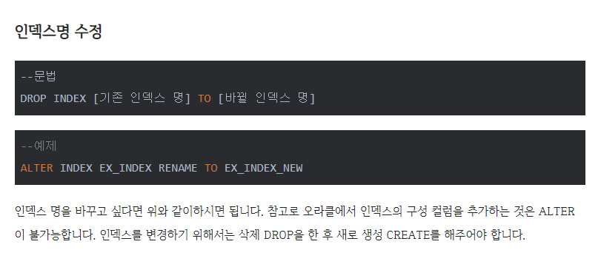
chaper 13
01
INDEX

Slide 8
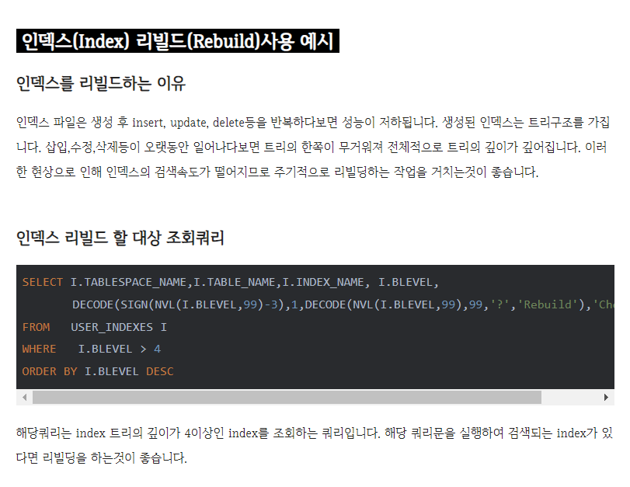
chaper 13
01
INDEX

Slide 9
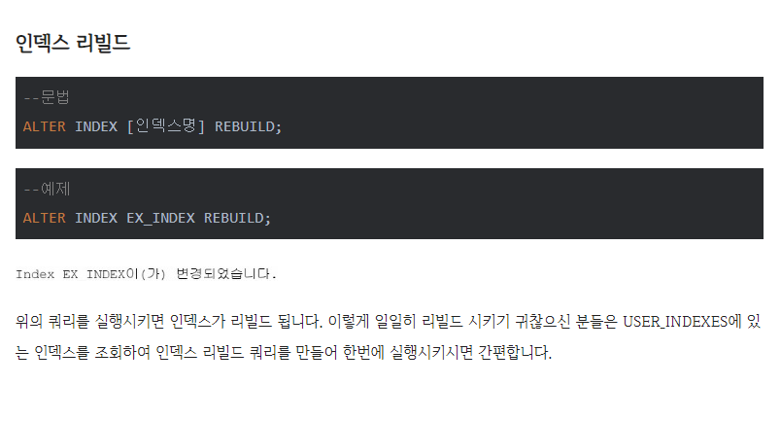
chaper 13
01
INDEX

Slide 10
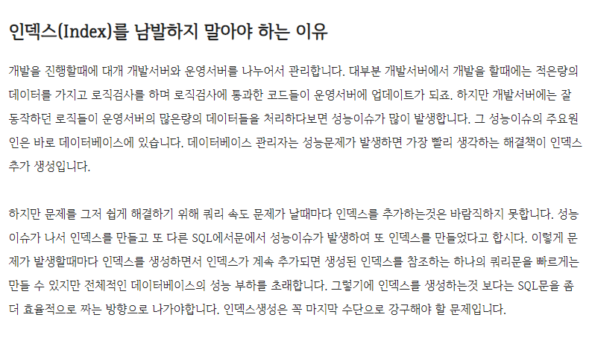
chaper 13
01
INDEX

Slide 11

chaper 13
01
INDEX

Slide 12
E N D.
고생하셨습니다

